Slide 1
Forest Fires Prediction with Meteorological Data
Zhiwei Wang
Aman Awana
Anjali Chintam

Slide 2
Problem Description
Forest fires create enormous economical and ecological damage and causes human suffering
Traditional forest-fires detection methods usually involve satellite-based, infrared/smoke scanners and local sensors
Equipment and maintenance costs can be very high.
In the study , we aim to predict the occurrence and area damaged due to wildfires, using meteorological data (temperature, rain, wind, etc.), which is easy to obtained.
A regression problem

Slide 3
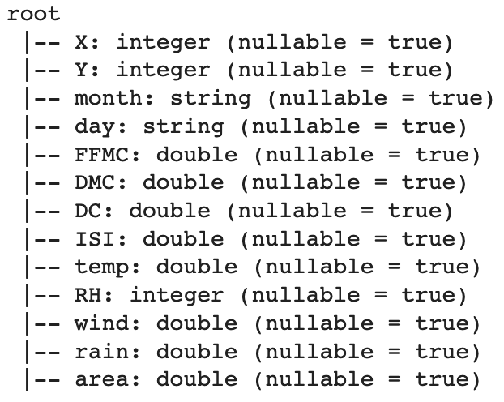
Data Description
Data Source: UCI ML Repository
Forest fires in Montesinho natural park in Portugal, 2000-2003
Target Variable: area (burned area)
Features:
Geographical
Temporal
Meteorological

Slide 4
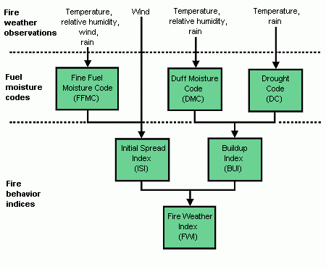
Features and Labels

Slide 5
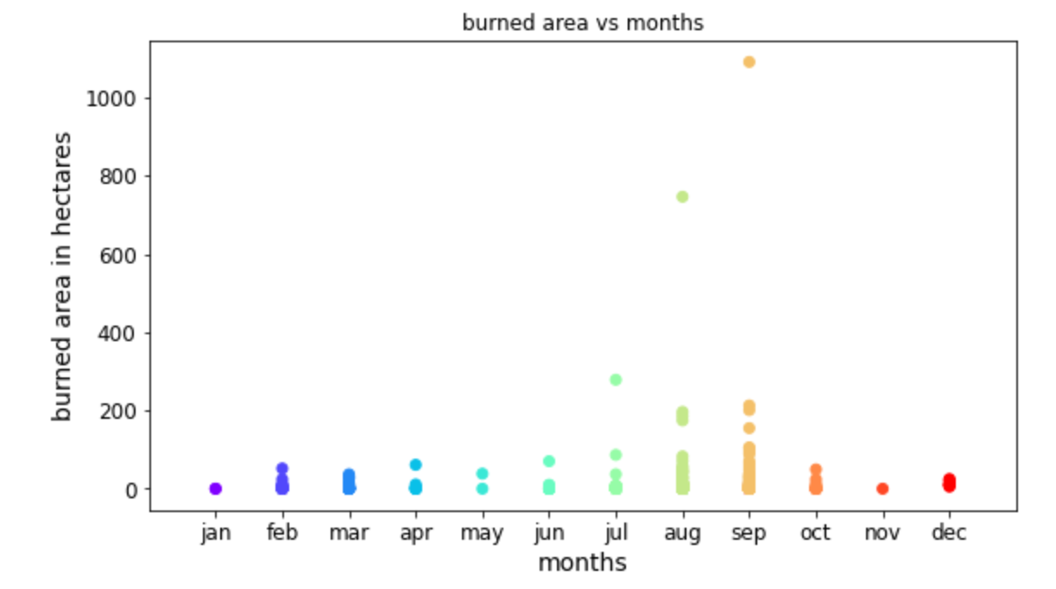
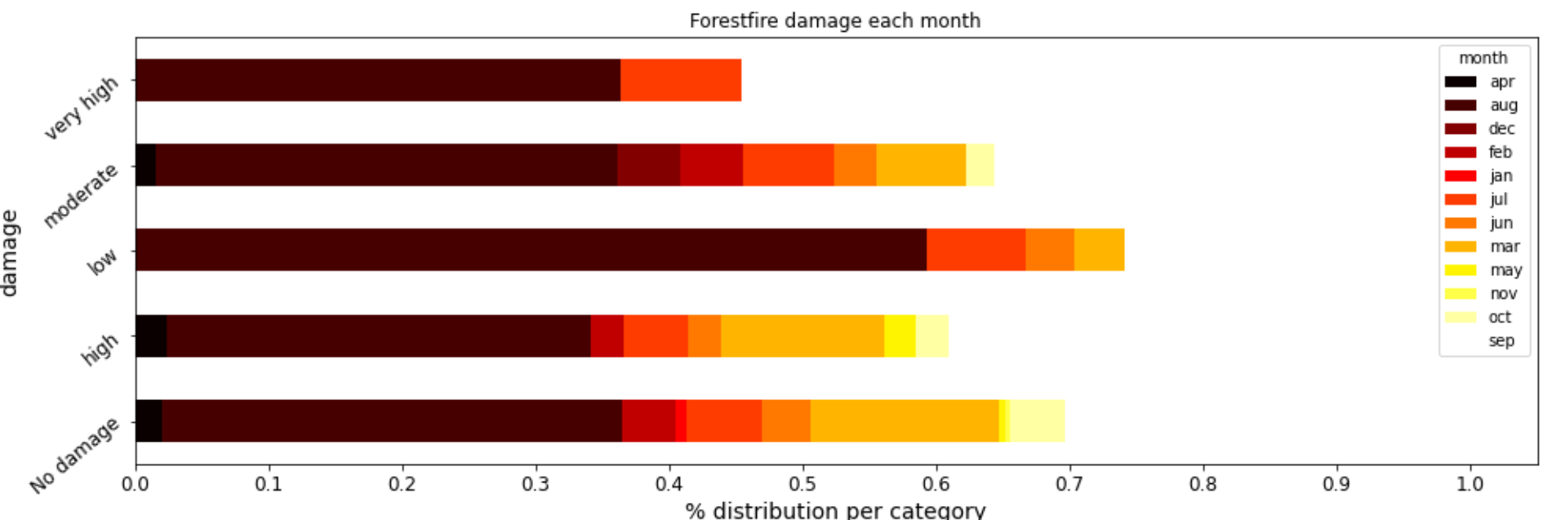
Exploratory Data Analysis

Slide 6
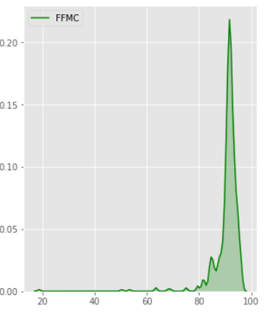
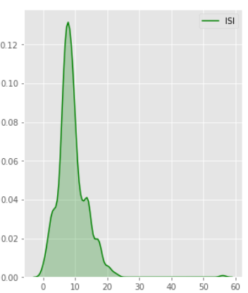
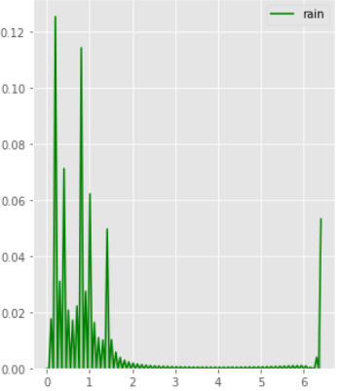
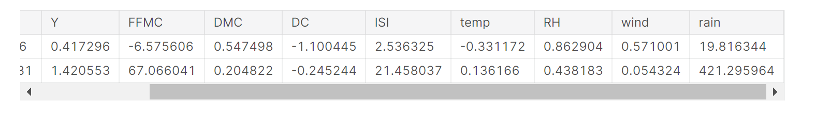



Univariate Plots

Slide 7
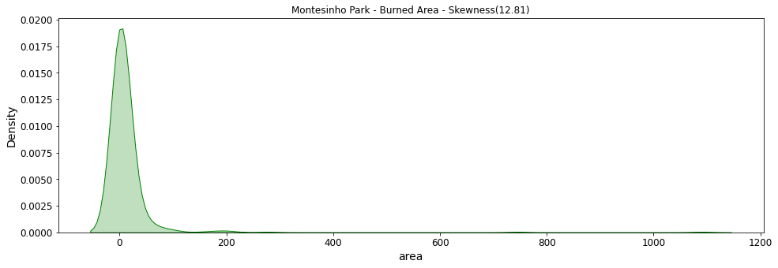
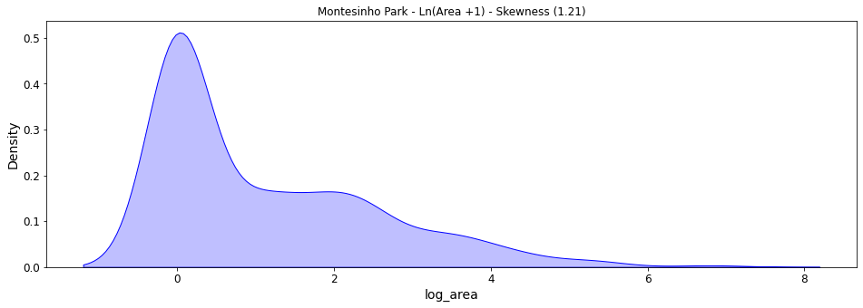
Log Transformation of Skewed Data
Target Variable is highly skewed towards 0
Ln(‘Burned Area’+1)
Skewness
Before: 12.81
After: 1.21
RMSE
Before: 32.77
After: 1.38

Slide 8
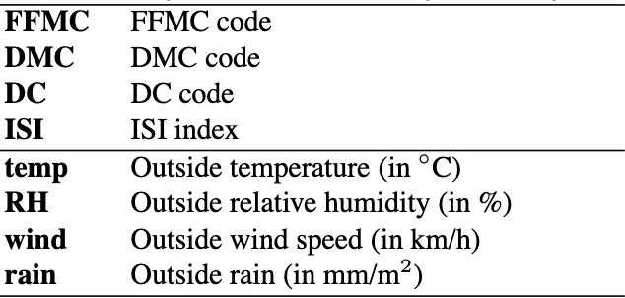
Predictors Selection
‘Temp’, ‘RH’, ‘wind’, ‘rain’
Reasons:
Interpretability
Collinearity

Slide 9
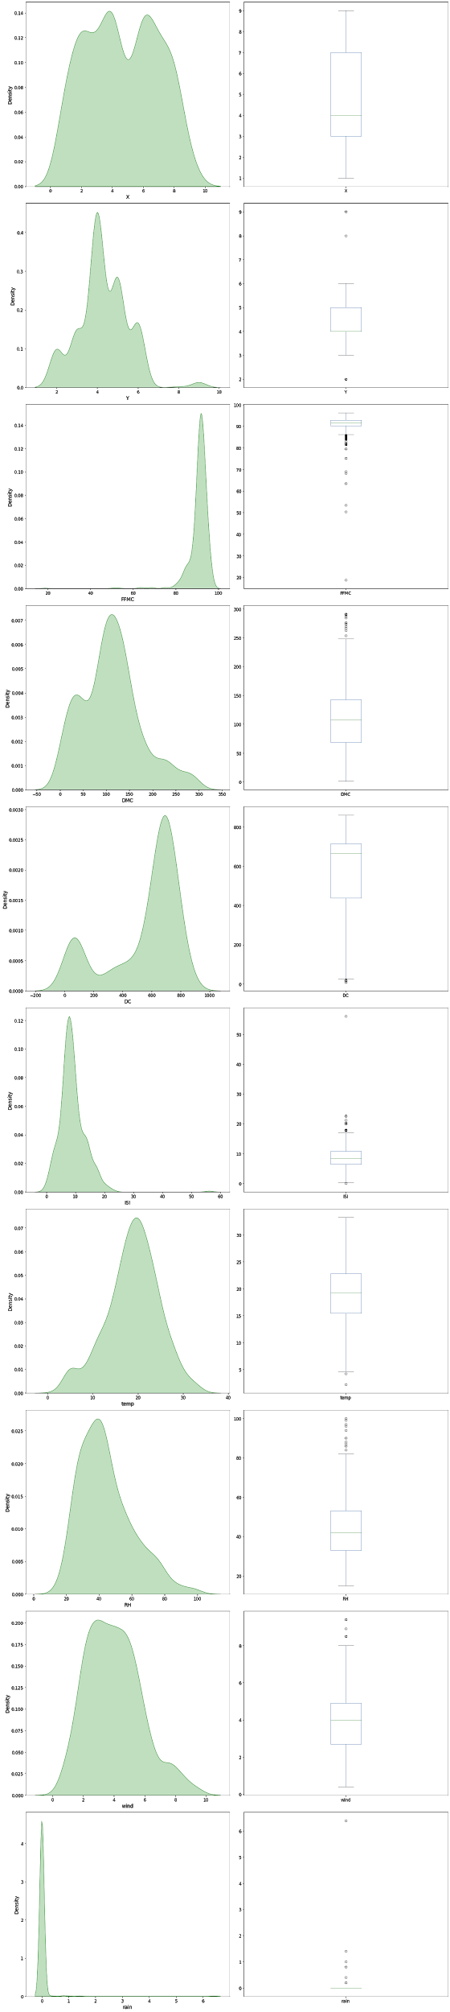
Predictors Examination
Among four predictors, ‘rain’ is the most skewed one.
Solution: remove one outlier
For ‘rain’ variable: only one data point is 6.4, while the rest is below 1.5
Skewness
Before: 19.76
After: 11.48
RMSE
Before: 1.38
After: 0.63

Slide 10
Regression Models Comparison
 | MSE | RMSE | MAE
Linear Regression | 0.39 | 0.63 | 0.5
Decision Tree Regression | 0.44 | 0.66 | 0.53
Gradient-boosted trees (GBTs) | 0.44 | 0.67 | 0.52

Slide 11
Inference
Coefficients Value | Variable
0.028701 | temp (Temperature)
-0.000842 | rh (Relative Humidity)
0.041607 | wind (Wind Speed)
-0.056932 | rain

Slide 12
Future Work
Attempting to minimize the cost and time required to respond to fires by identifying where firefighting assets should be staged so that they are as close as possible.
Partitioning the locations of past burns into clusters whose centroids can be used to optimally place heavy fire fighting equipment as near as possible to where fires are likely to occur. K means clustering is better suited for this.

Slide 13
Team Contribution
Aman Awana : Exploratory Data Analysis, Linear Regression, Decision Trees regressor
Anjali Chintam : Exploratory Data Analysis, Linear Regression, Cross-validaton, Grid Search
Zhiwei Wang : Exploratory Data Analysis, Gradient Boosting and Linear regression

Slide 14
Thankyou !!

